Slide 1
INTRODUCTION TO MARKETING
0
Chapter 3
The Cultural
Environment
NGUYEN THI PHUONG*
THANG LONG UNIVERSITY
*MA in Global Marketing, PHD in Economics

Slide 2
COURSE MATERIAL
1. W. D. Perreault, Jr., J.P Cannon, and E. J. McCarthy (2009), Basic Marketing: A Marketing Strategy and Planning Approach, 17th ed., Irwin/McGraw Hill.
2. C. H. Mason and W. D. Perreault, Jr. (2002), The Marketing Game!, Third edition, McGraw-Hill, New York.
Copyright © 2011 Pearson Education
15-<number>

Slide 3
GRADING
Class Participation 10%
Mid-Term Exam 30% (MCQ and essay questions)
Final Exam 30% (MCQ and essay questions)
Group Presentation* 30%
*Teamwork for a strategic market audit for a given companies such as Vinamilk, KFC, Zara Vietnam, etc
Copyright © 2011 Pearson Education
15-<number>

Slide 4
CLASS POLICIES
Attendance is required. If you come, be prepared to be a part of the class.
Food and drink are allowed, presuming that food/drink related noises are kept to a minimum (In other words, no noisy bags/wrappers).
Cell phones: cell phones should be off or silenced, and should not be used for text messaging during class.
Sleeping: Please avoid sleeping in class.
Late assignments will not be accepted.
Copyright © 2011 Pearson Education
15-<number>

Slide 5
TEACHING SCHEDULE
Session 1: Introduction: creating value
Session 2: Marketing strategy
Session 3: Analyzing the market environment
Session 4: Marketing information
Session 5: Consumer buying behavior
Session 6: Segmentation, targeting, and positioning
Session 7: Mid-term exam
Session 8: Product and brand strategy
Session 9: Product development
Session 10: Pricing
Session 11: Marketing channels
Session 12: Communication
Session 13: The global marketplace
Session 14: Review
Copyright © 2011 Pearson Education
15-<number>

Slide 6
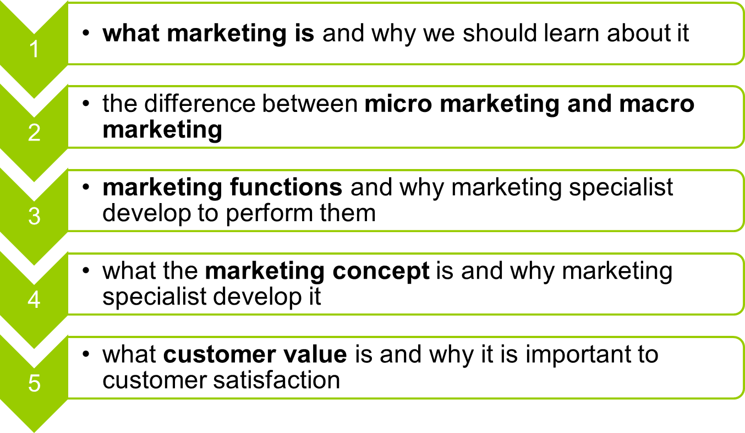
SESSION 1: Introduction: creating value
Copyright © 2011 Pearson Education
15-<number>

Slide 7
Why Marketing is important?
To be an intellectual consumer: Studying marketing makes sense for an educated consumer to understand what you get and do not get
To your job: Studying marketing offers many exciting and rewarding career opportunities
To understand a part of economic growth and development: marketing encourages research and innovation through the development of new ideas, goods and services
Copyright © 2011 Pearson Education
15-<number>

Slide 8
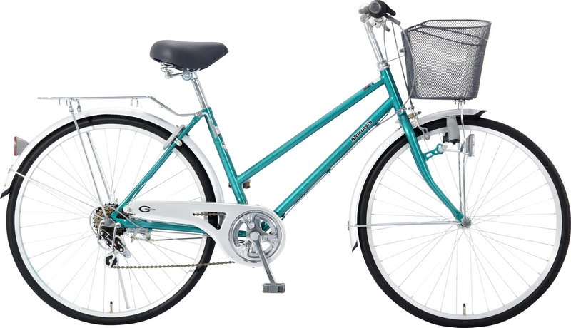
1.1 MARKETING DEFINITION
Marketing means “selling” or “advertising”?
Question 1: Let’s find out some activities a firm should do before and after producing and selling a bike
(Analyze the needs of people, type of bikes, how many, price, promotion, competitors, warranty, etc)
Copyright © 2011 Pearson Education
15-<number>

Slide 9
Question 2: Let’s students find out some activities show a university should do before and after the decision for enrollment
Definition: Marketing is the performance of activities that seek to accomplish an organization’s objectives by anticipating customer or client needs and directing a flow of need-satisfying goods and service from producer to customer or client.
Copyright © 2011 Pearson Education
15-<number>

Slide 10
Some Terms
Organization’s objectives: maximize profit
Anticipate customer needs: determine what goods and services to be developed to satisfy the desire of customers
A flow of need: not a single transaction but also building a long-lasting relationship that benefits both firm and the customer.
Copyright © 2011 Pearson Education
15-<number>

Slide 11
Performance of activities: design and packaging; prices or fees; credit and collection policies; intermediaries; transporting and storing polices; advertising and sales policies; installation; customer service; warranty; disposal policies
Producer: profit and non-profit organizations.
Customers or clients: individual consumers, business firms, NGO, government agencies or foreign nations.
Product: a physical good, a service or even an idea
Copyright © 2011 Pearson Education
15-<number>

Slide 12
Question 3: When does marketing occur? Which kind of economy that marketing does not happen?
Marketing occurs when two or more parties are willing to exchange something for something else. With a pure subsistence economy, there is no need to exchange goods and services
Copyright © 2011 Pearson Education
15-<number>

Slide 13
1.2 Micro and macro views of marketing
Micro view: marketing as a set of activities done by an individual organization to satisfy the customers
Macro-marketing view: is a social process that directs an economy’s flow of goods and services from producers to consumers in a way that effectively matches supply and demand and accomplishes the objectives of society
In a market-directed economy, price is a measure of value of particular goods and services.
Copyright © 2011 Pearson Education
15-<number>

Slide 14
1.3 Marketing functions
Functions of marketing are:
buying, selling, transporting, storing, standardization and grading, financing, risk taking and market information.
Exchanges are often easier or less expensive when a marketing specialist performs some of marketing functions.
Copyright © 2011 Pearson Education
15-<number>

Slide 15
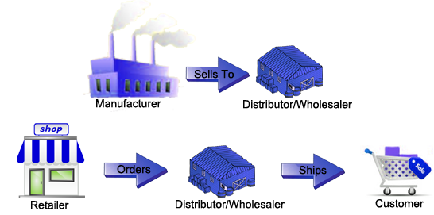
Marketing specialist
Intermediaries
Marketing collaborators
retailers
wholesalers
advertising agencies
marketing research firm
testing laboratories internet service providers
transporting firms
communication companies
financial institutions
Copyright © 2011 Pearson Education
15-<number>

Slide 16
1.4 Marketing concept
Well-managed firms have replaced this production orientation with a marketing orientation. A marketing orientation means trying to carry out the marketing concept
The marketing concept means an organization aims all its effort at satisfying its customers at a profit
A marketing-oriented firm tries to offer customers what they need.
Copyright © 2011 Pearson Education
15-<number>

Slide 17
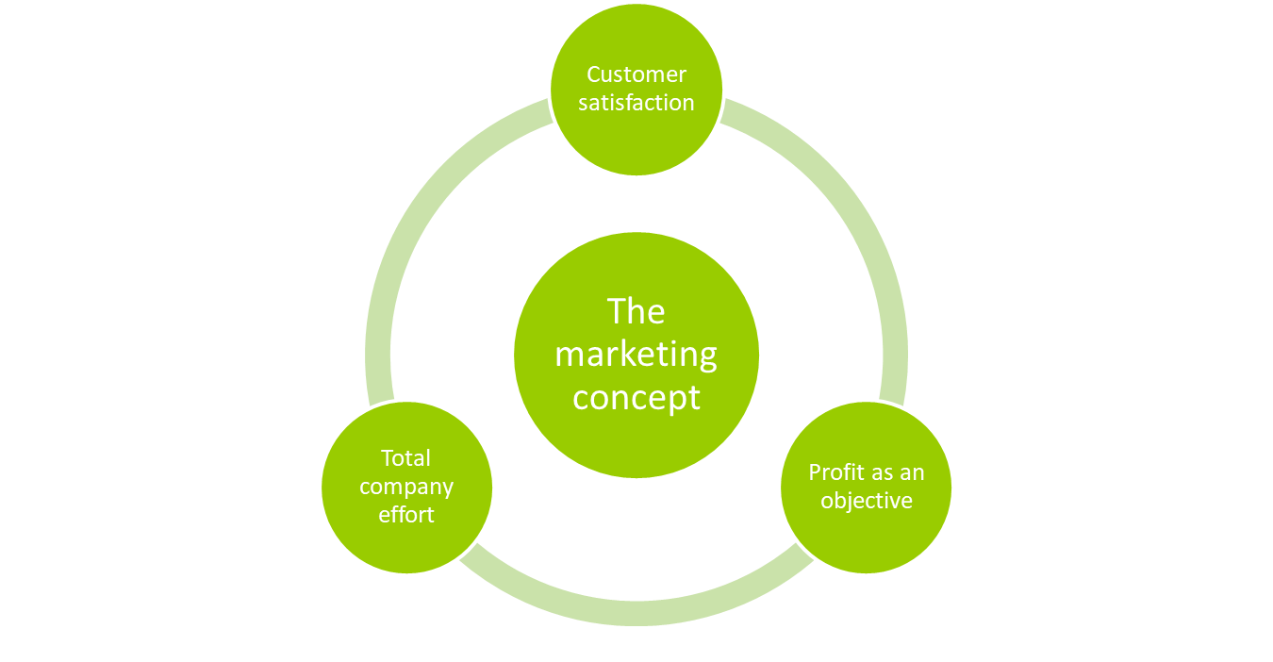
Basic ideas of marketing concept
Source: W. D. Perrault, Jr., J.P Cannon, and E. J. McCarthy (2009)
Copyright © 2011 Pearson Education
15-<number>

Slide 18
Marketing orientation and production orientation
Topic | Marketing orientation | Production orientation
Attitudes toward customers | Determine customer’s wants | trying to cut costs
Product offering | Company makes what it can sell | Company sell what it can make
Role of marketing research | determine customer needs and how well company is satisfying them | determine customer reaction
Customer service | Satisfying customer after the sale and he will come back again | An activity required to reduce consumer complaints
Focus of advertising | Benefit of goods and services | Product features and how products are made
Relationship with customer | Customer satisfaction before and after sale, long-run relationship | Relationship ends when a sale is made
Costs | Eliminate costs that do not give value to customers | keeps costs as low as possible
Copyright © 2011 Pearson Education
15-<number>

Slide 19
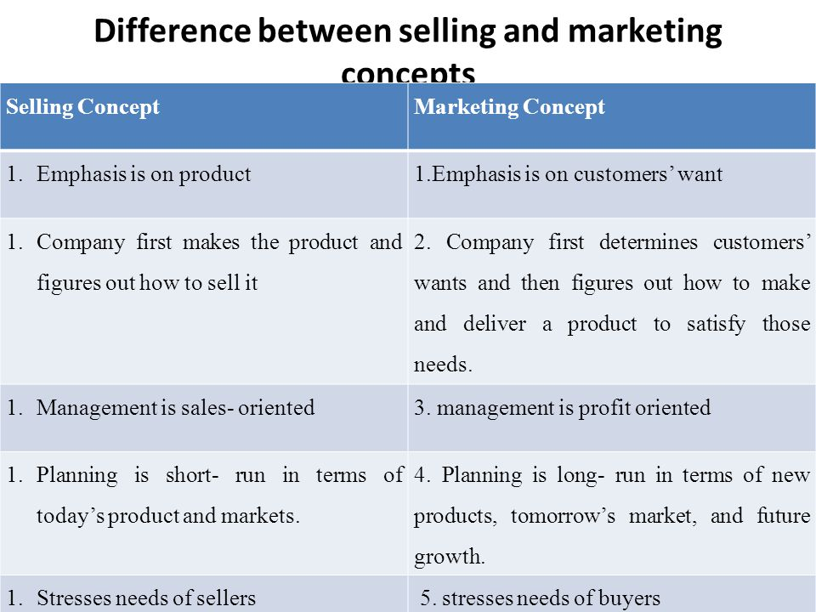
Selling and Marketing concepts
Copyright © 2011 Pearson Education
15-<number>

Slide 20
1.5 Customer value
Question 4: low price and high customer value are the same thing?
A good or service that doesn’t meet consumer’s need will result in low customer value, even if the price is low
Copyright © 2011 Pearson Education
15-<number>

Slide 21
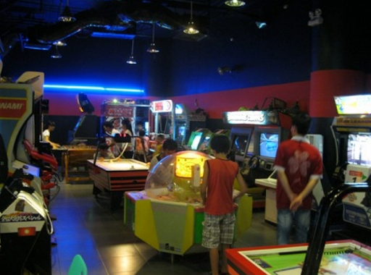
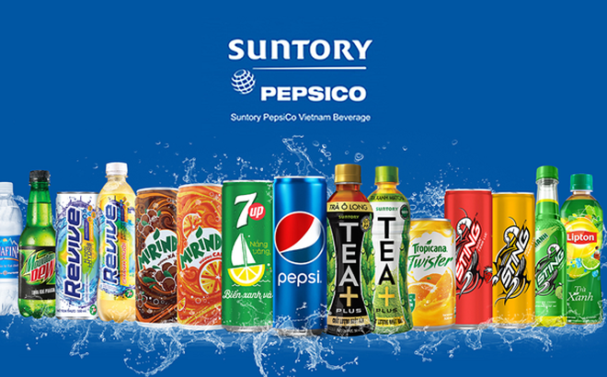
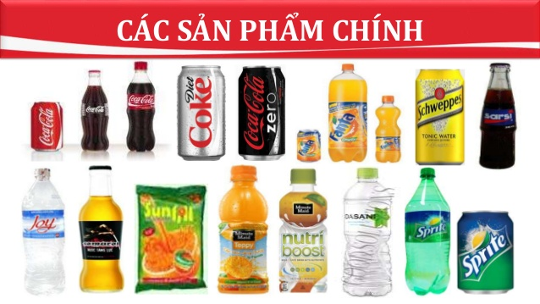
Examples in improving customer value
Example 1: Big C supermarket
Example 2: Pepsi and Coke competition
Copyright © 2011 Pearson Education
15-<number>

Slide 22
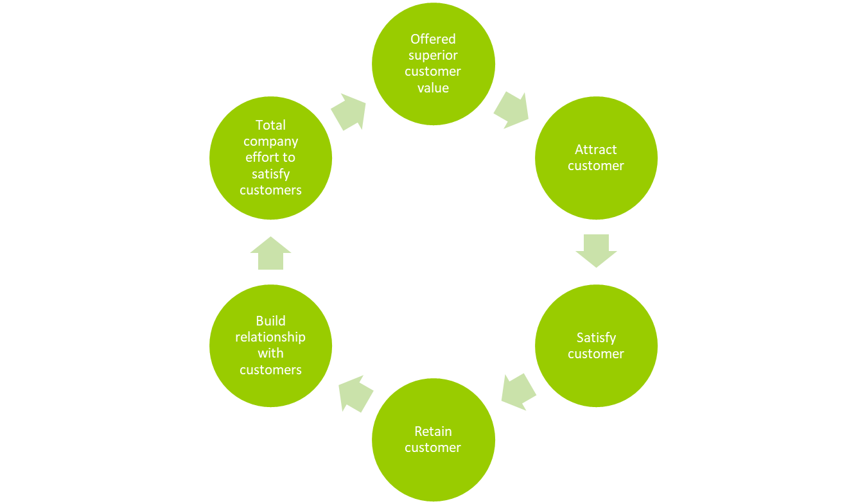
Build relationship with customer value
Copyright © 2011 Pearson Education
15-<number>

Slide 23
Firm adopted marketing concept=> focuses on customer satisfaction=>superior customer value=> attract customers and keeps them satisfied=> purchase from the firm again.
The relationship with customers is profitable, so the firm is encouraged finding better ways to offer superior customer value.
Copyright © 2011 Pearson Education
15-<number>

Slide 24
Homework
1. Explain why a market-directed and macro-marketing system encourages innovation. Give an example
2. Distinguish between production orientation and marketing orientation, illustrating with local examples
3. Give an example of a recent purchase you made where the purchase was not just a single transaction but rather part of an on-going relationship with the seller. Discuss what the seller has done (or could do better) to strengthen the relationship and increase the odds of you being a loyal customer in the future.
Copyright © 2011 Pearson Education
15-<number>

